Slide 1
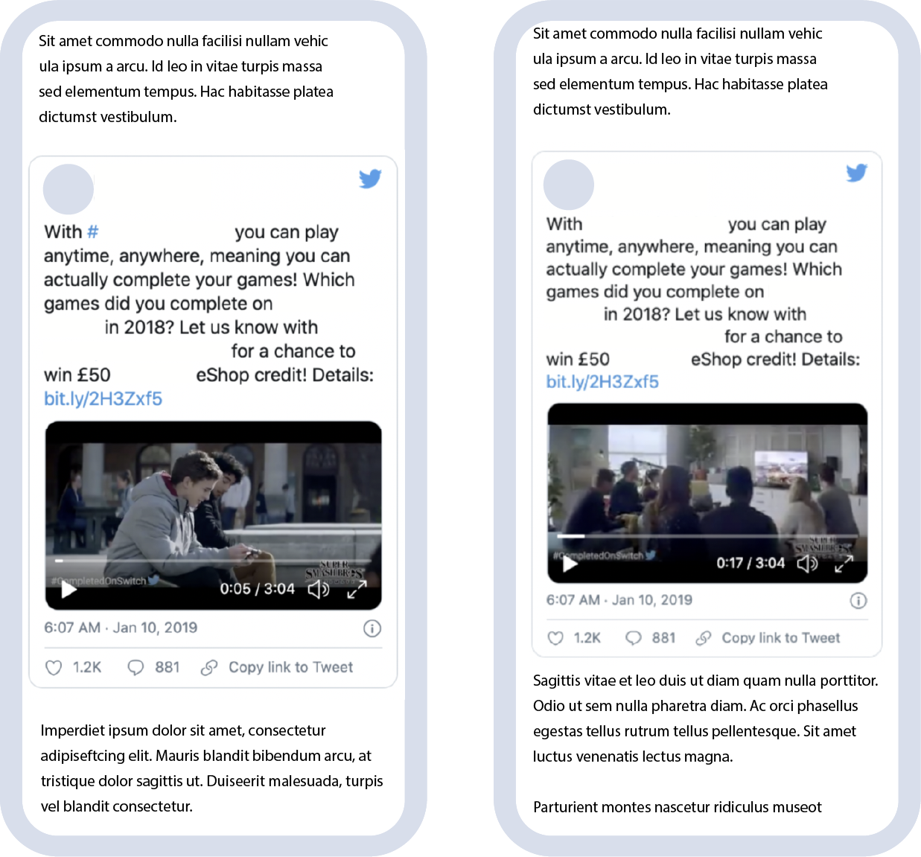
Case Study: Engagement
Consumer electronic brand increased brand engagement through growth in action intent, social interactions, and website visits.
1. Objective
This consumer electronic brand wanted to increase brand engagement among its target audience.
2. Solution
This brand repurposed their already existing social creatives instead of using standard display creatives. Our familiar format and increased size led to increase website clicks and social interactions.
3. Results
The brand saw a 55% increase in intent to purchase the product, a 77% increase in interactions on social media, and a 33% increase in website visits compared to standard display.
`
55%
77%
33%
Increase in
action intent
Increase in
social interactions
Increase in
website visits

